Slide 1
Relative Dating

Slide 2
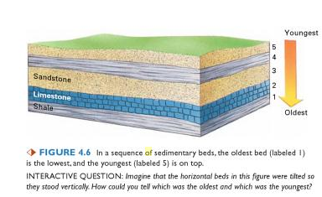

Principle of Superposition
Older layers are on bottom

Slide 3
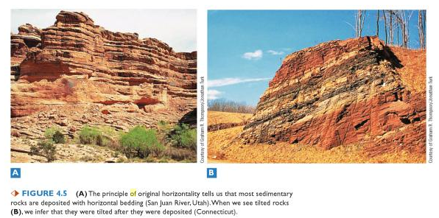
Principle of Original Horizontality
Layers form flat – if they aren’t flat something happened after formation

Slide 4
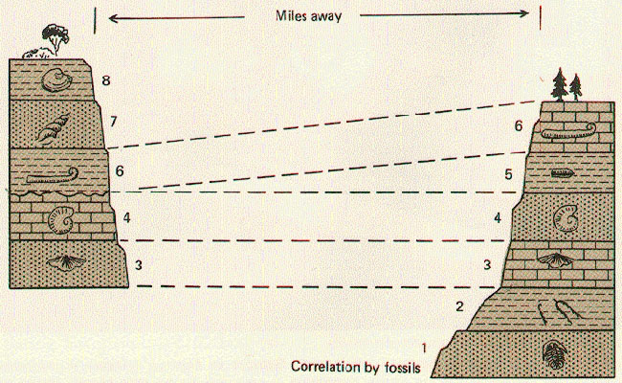
Principle of Faunal Succession
Rocks with similar fossils have similar ages – sometimes layers go missing
(Photo courtesy of The Changing Earth - Introduction to Geology (2nd ed.), by Mears, Jr., D. Van Nostrand Co., 1977)

Slide 5
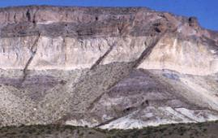
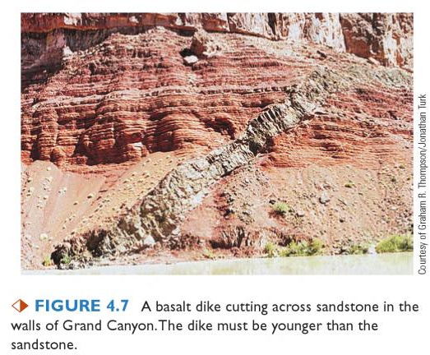
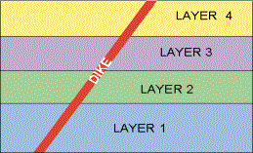
Principle of Cross-cutting/Inclusion
Anything that cuts across layers is newer.
Dikes and sills are made of igneous rock (cooled lava)

Slide 6
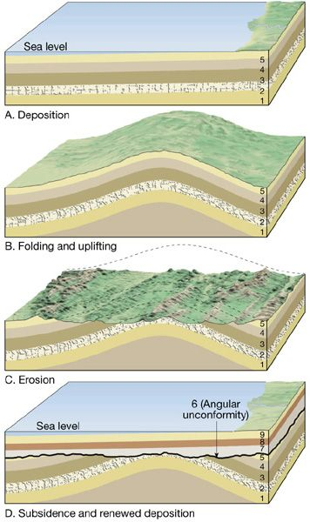
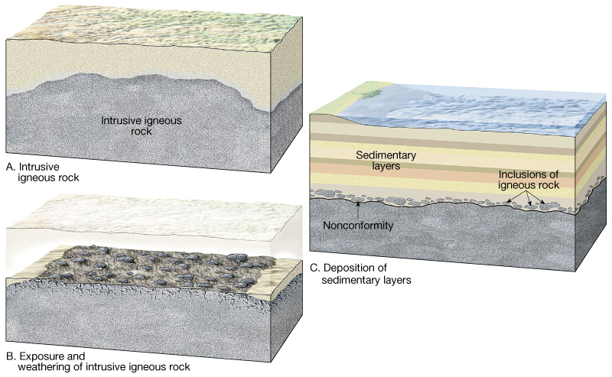


Unconformities: Something doesn’t look right here…
Angular Unconformity
Folding & Uplifting
Nonconformity
Weathering & Erosion
Igneous rock
Intrusive
Plutonic
Sedimentary Rock Deposition
Weathering & Erosion
New Deposition

Slide 7
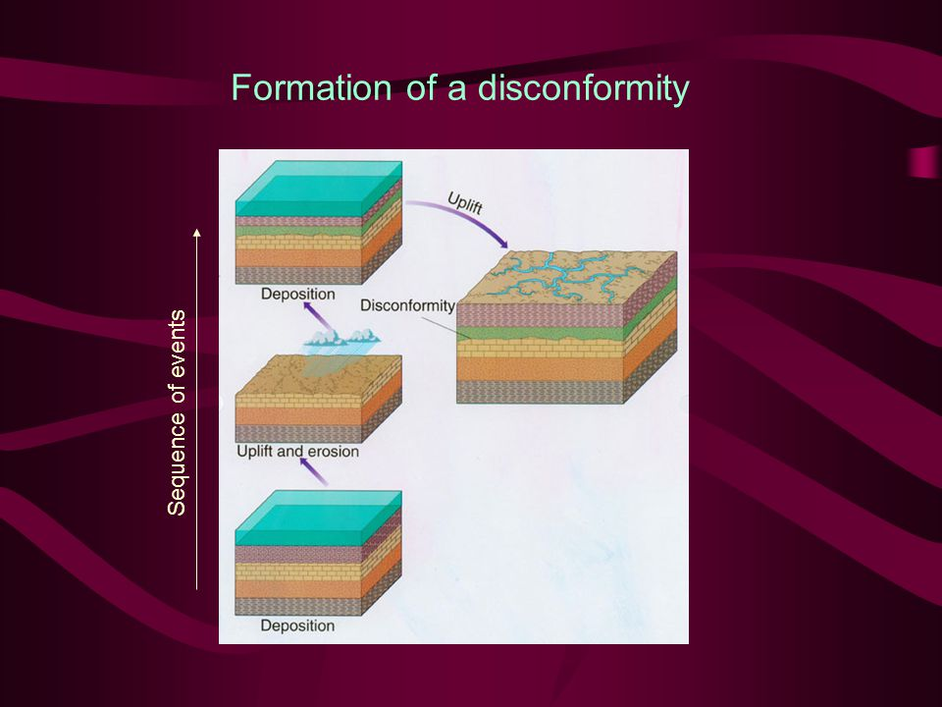
Unconformities
Nonconformity
Disconformity
Sedimentary
Igneous rock
Intrusive
Plutonic
Sedimentary Rock Deposition
Weathering & Erosion
Just like nonconformity, but sedimentary rock erodes, more sedimentary deposits
Sedimentary

Slide 8
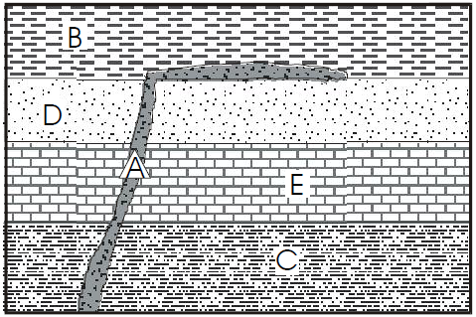
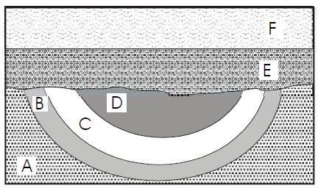
Examples of Relative Dating
Notes:
Abcdef cedba

